Slide 1
Learning Stream
Supervisors and Managers aka Proxy

Slide 2
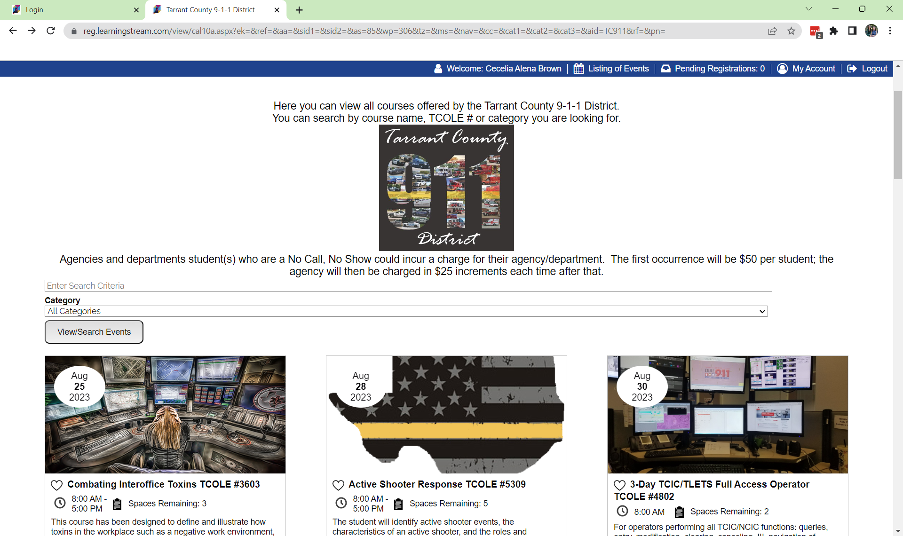

Slide 3
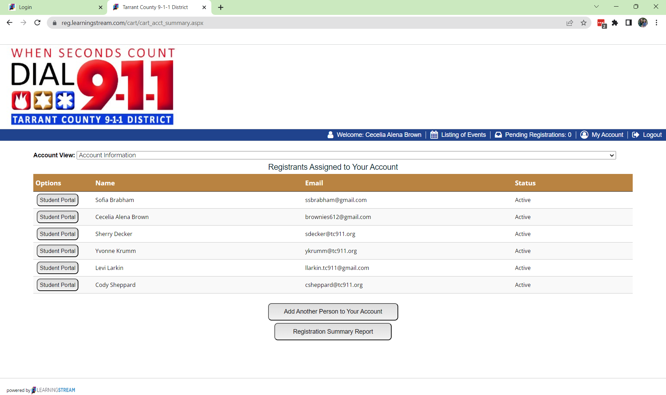
Creating a New Account
Unlike the previous system; only create a new account when signing that person up for a class.
You must be a proxy (we can help with this)
Do not create the account through this page:

Slide 4
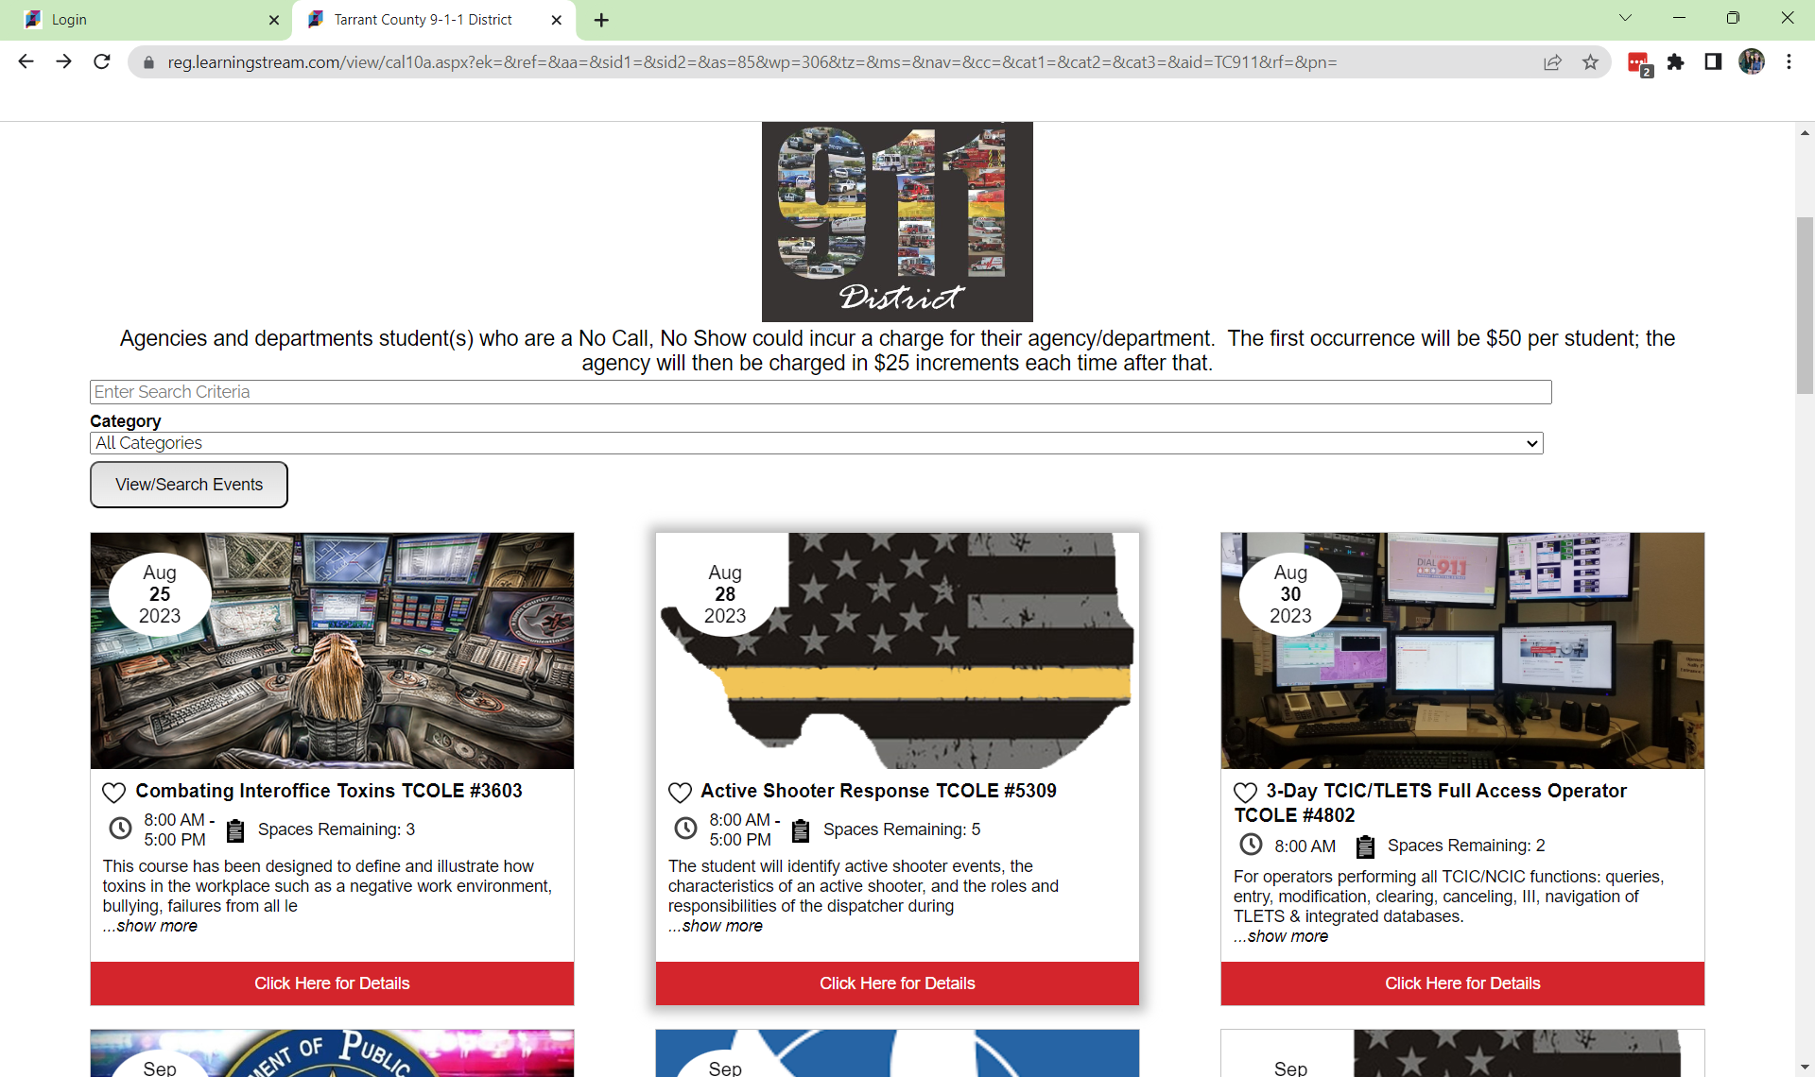
Creating a New Account
Select the Active Shooter course for the new employee.
Go into the course you want to sign them up for:

Slide 5
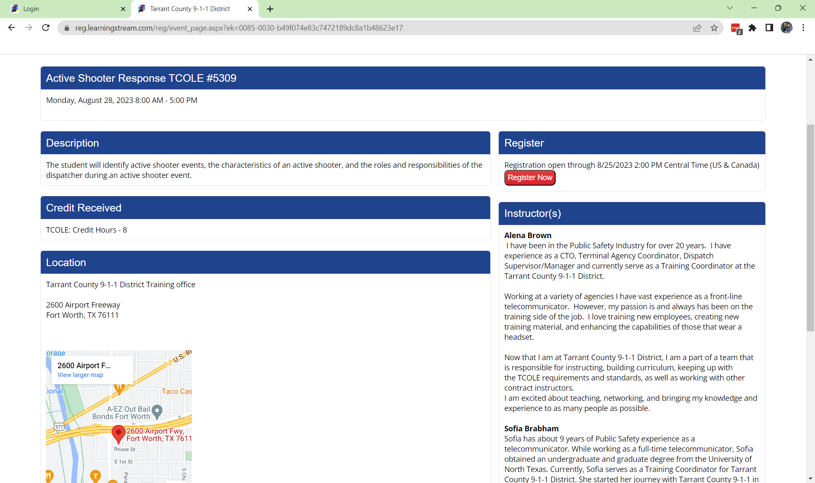
Creating a New Account
From here: Click the Red Register Now Button.

Slide 6
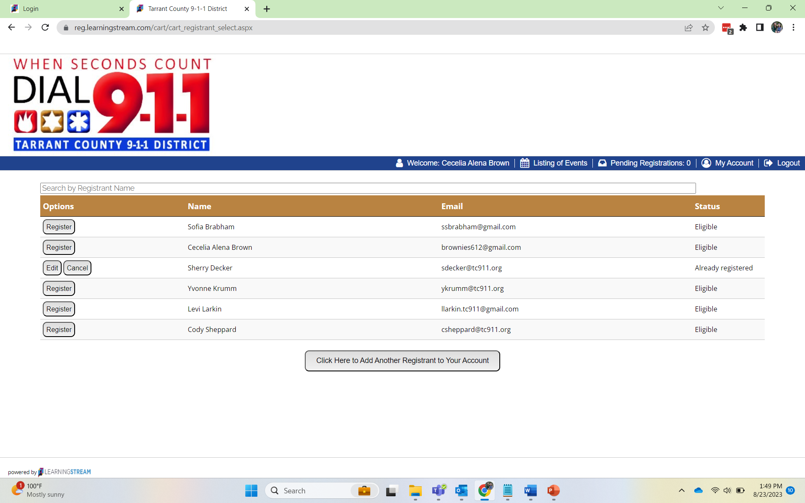
Creating a New Account
This is where you will select:
Click Here to Add Another….

Slide 7
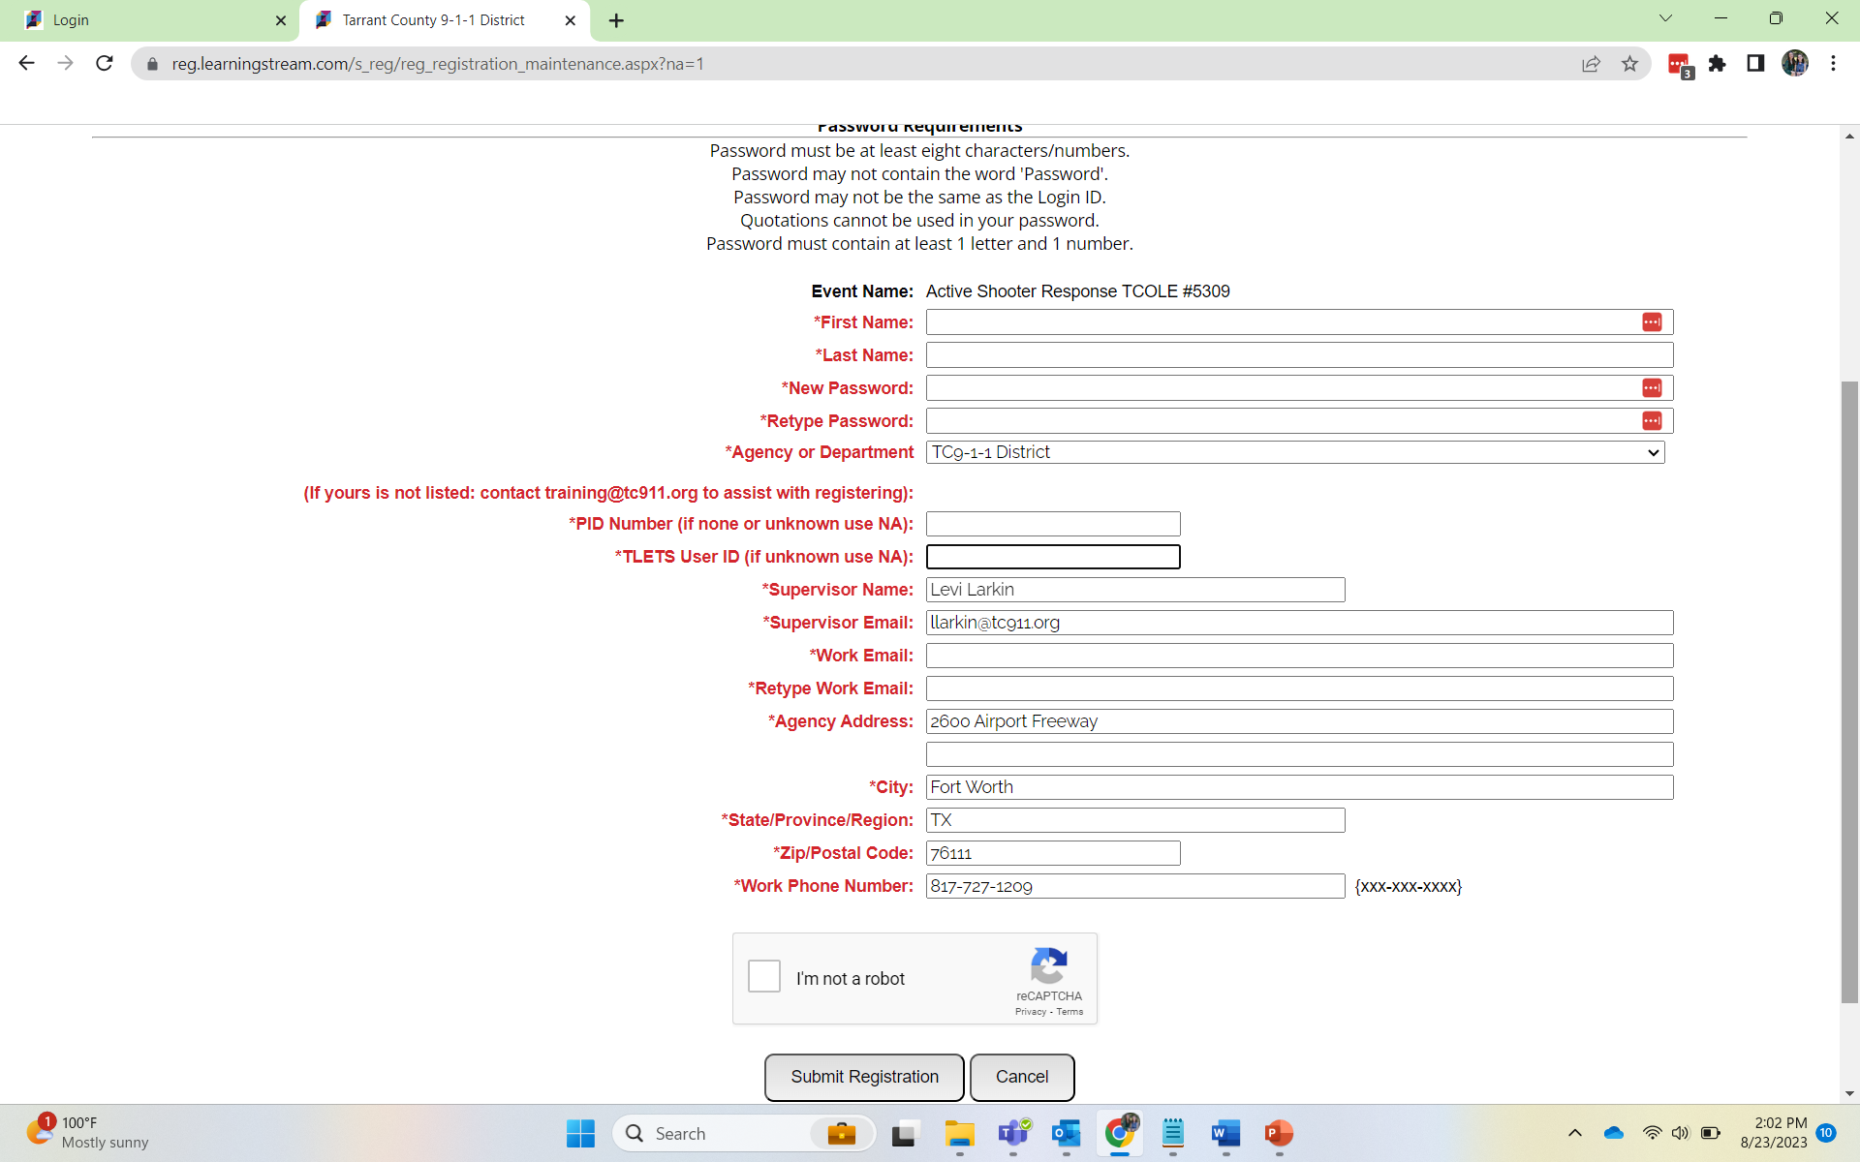
Creating a New Account
You may see fields are filled automatically. Just delete and enter the correct information if needed.
All fields are required.
You set the password for them.

Slide 8
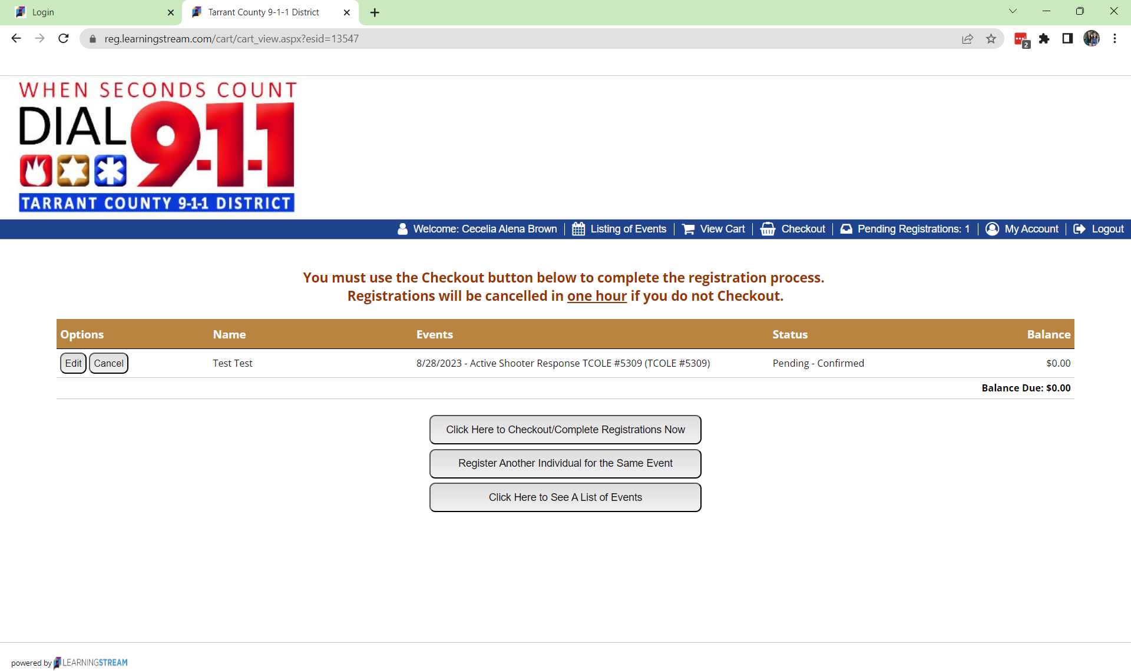
Don’t Forget
When registering someone for a class, you are not done until you submit through this page.

Slide 9
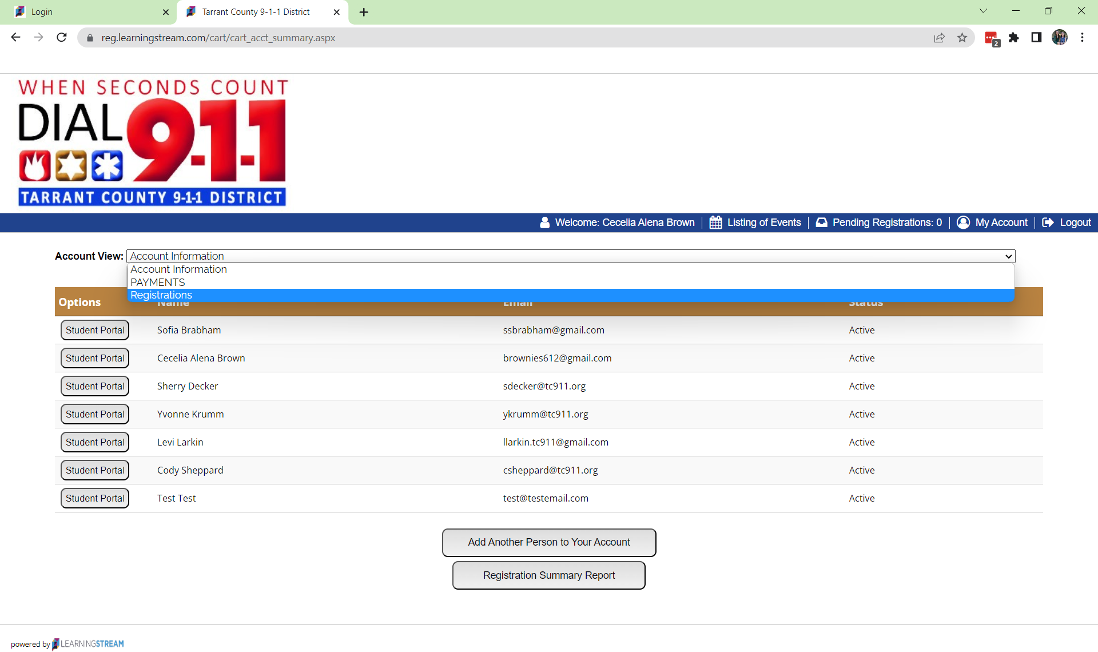
Registrations / Cancellations

Slide 10
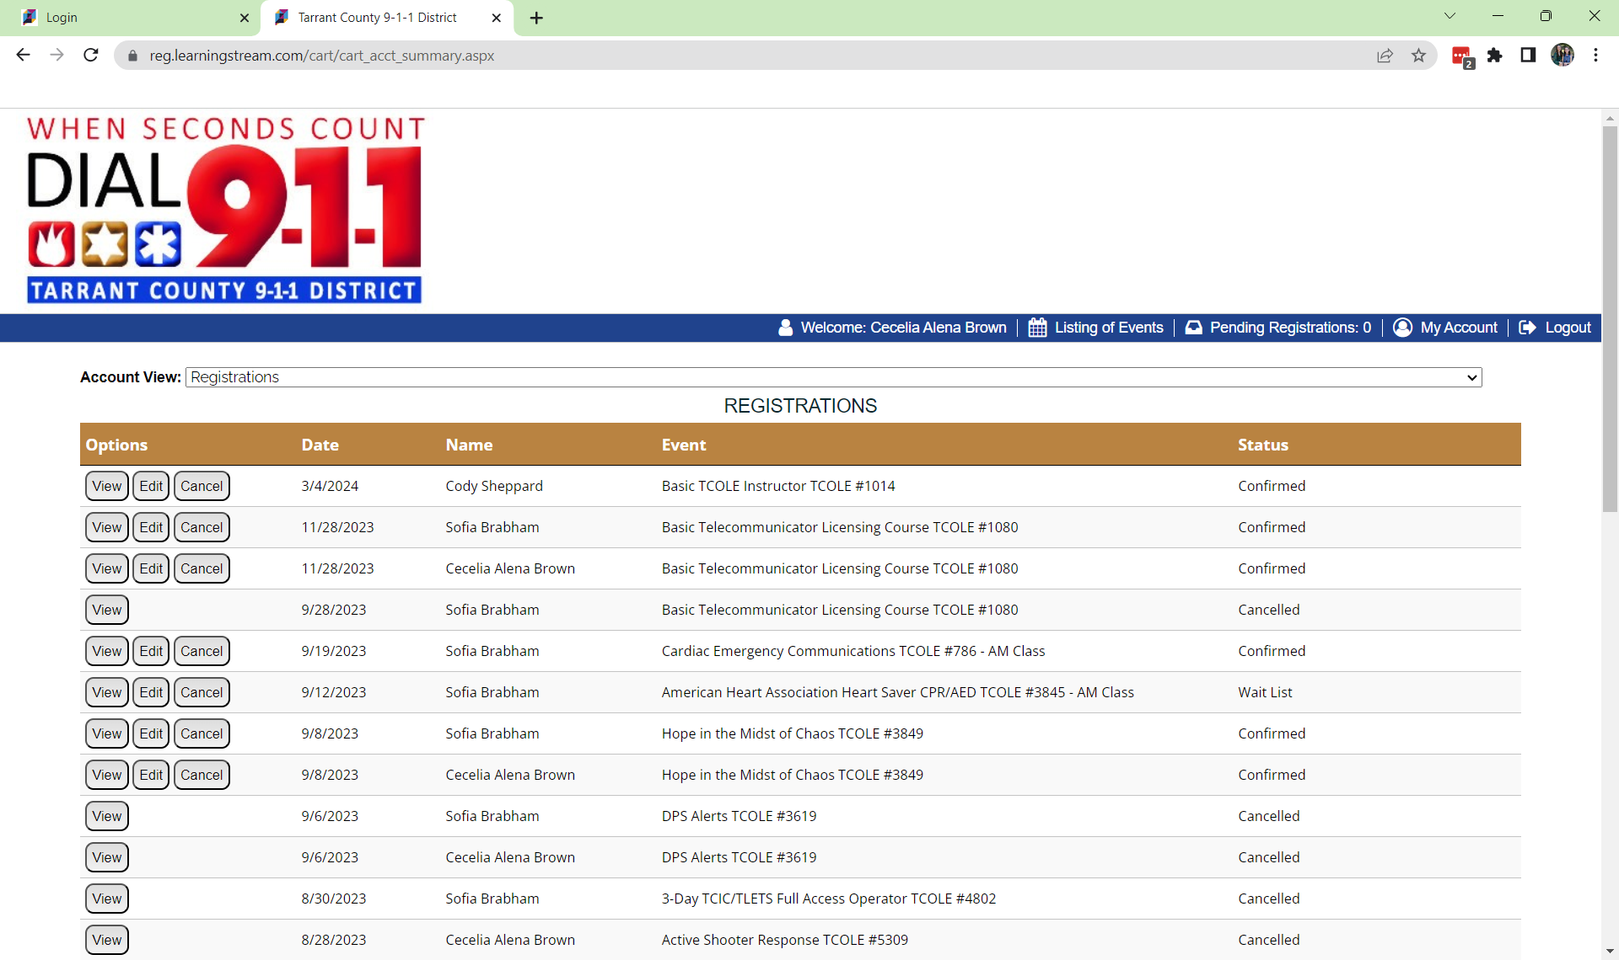
Registrations / Cancellations

Slide 11

We are Here to Help!!!!
Training@tc911.org
Alena Brown
cbrown@tc911.org

